Slide 1

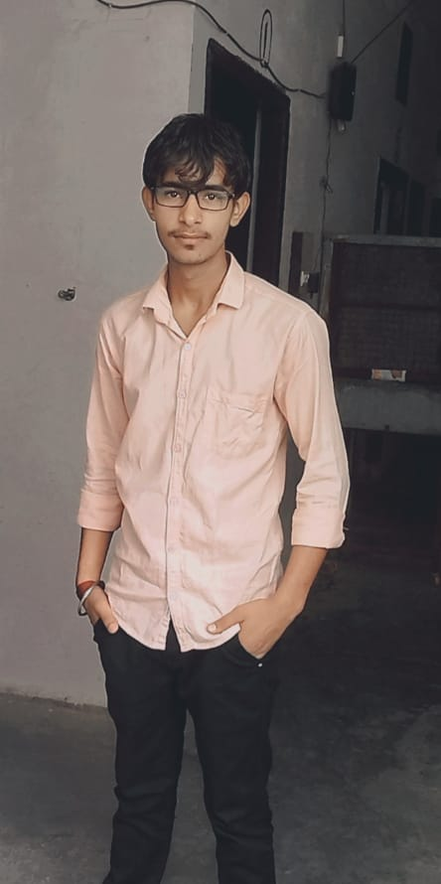
St. Andrews institute of technology and management
Name- Dharm Dutt
Branch- B.tech CST
Roll no,- 226054
Guided by- Gravit sir

Slide 2
index
Introduction
Tittle
About us
Navigation bar
Login and contact us page
Main page
footer

Slide 3
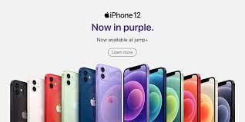
I PHONE SHOP

Slide 4
About us
The iPhone is a smartphone made by Apple that combines a computer, iPod, digital camera and cellular phone into one device with a touchscreen interface. The iPhone runs the iOS operating system, and in 2021 when the iPhone 13 was introduced, it offered up to 1 TB of storage and a 12-megapixel camera.

Slide 5
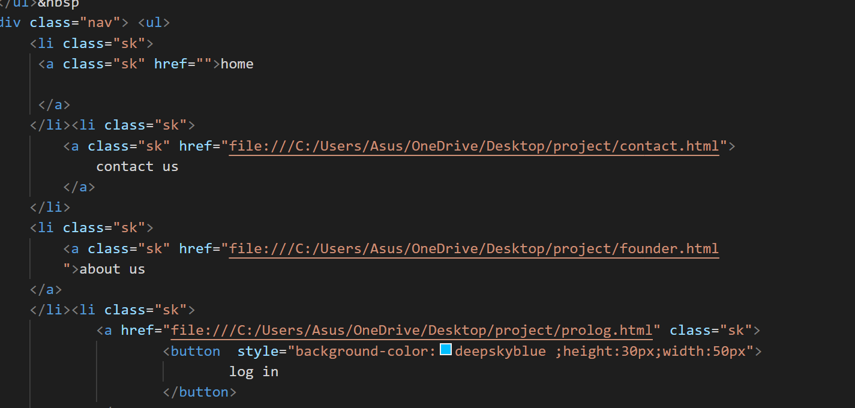
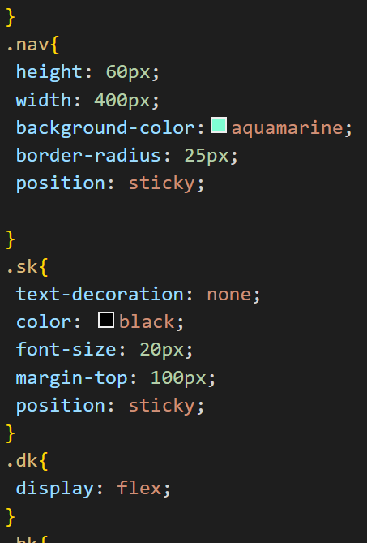
Navigation bar

Slide 6
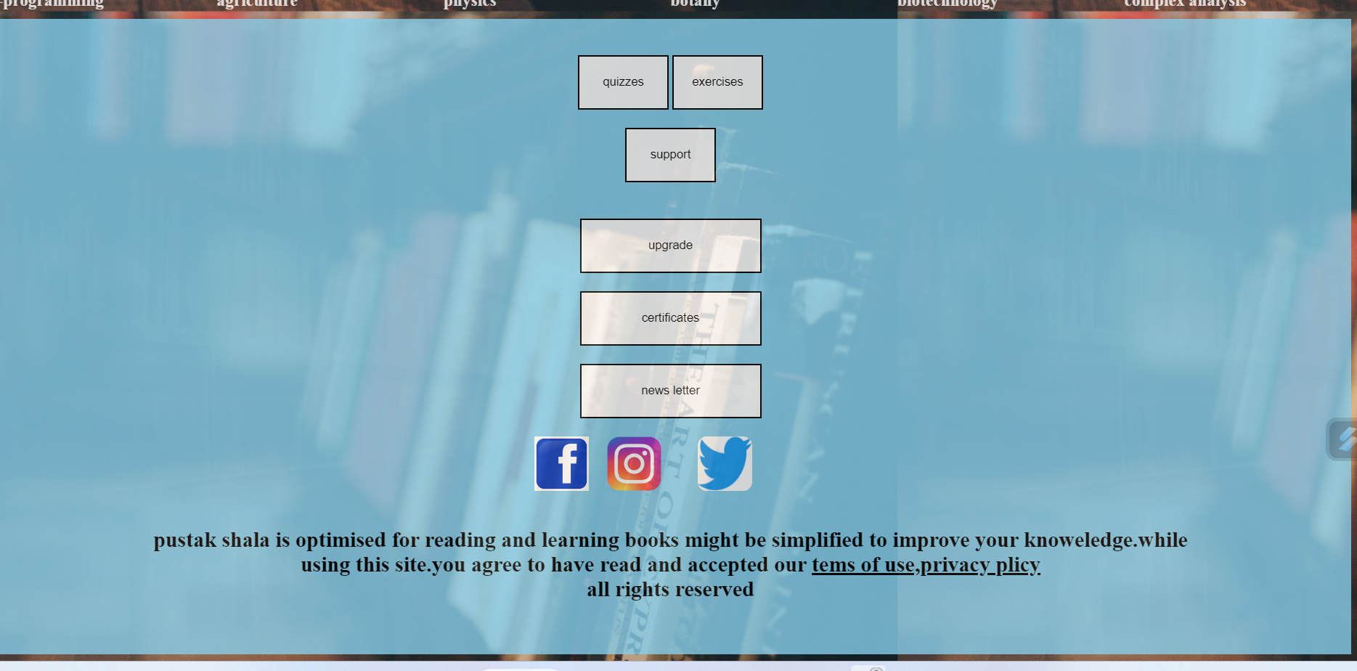
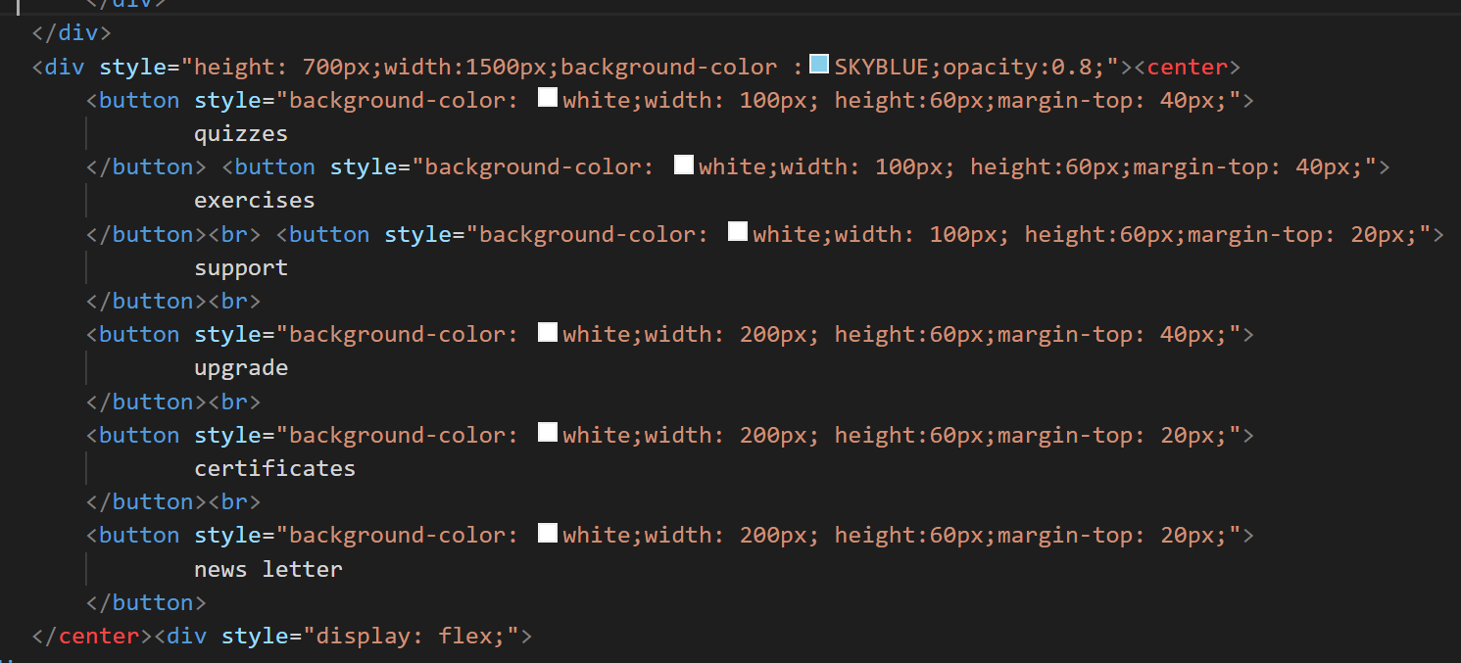
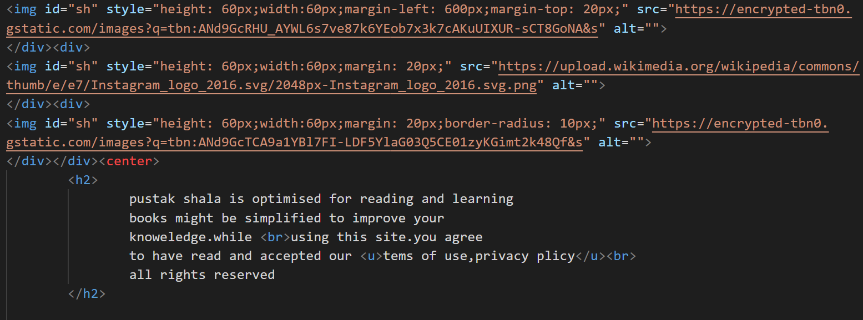
footer

Slide 7

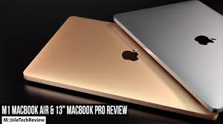
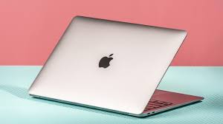
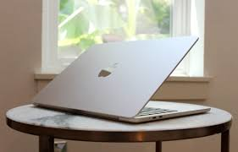
laptop’s

Slide 8


